Slide 1


Adversary Emulation Framework
Mentors: Dr. Alcides Alvear Suarez & Robel Campbell
Integrants: Kiara Rivera Domenech, Genesis Resto, Carlos Roque
Date: February 28th, 2023

Slide 2
Table of Contents
Solution
Command and Control Framework (C2)
Structure Diagram
References
Q&A
G. Resto, K. Domenech, C. Roque Adversary Emulation Framework

Slide 3

Solutions
G. Resto, K. Domenech, C. Roque Adversary Emulation Framework

Slide 4

Command and Control Framework
Dynamic Evasion – Variable Syscalls, ETW/AMSI Patching
In-memory Execution – Download Cradles, Microcontroller
Encrypted Payloads – AES-256, XOR
G. Resto, K. Domenech, C. Roque Adversary Emulation Framework

Slide 5
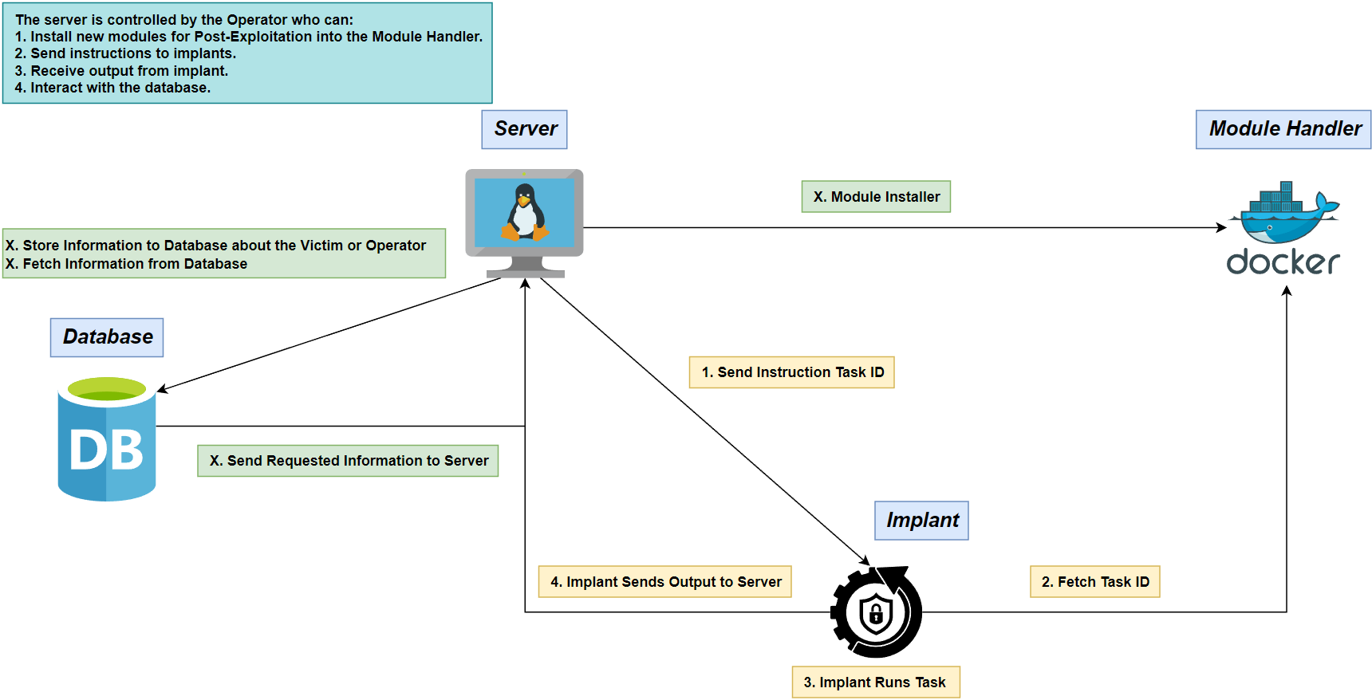
Structure Diagram
G. Resto, K. Domenech, C. Roque Adversary Emulation Framework

Slide 6
Initial Backlog

Slide 7
Implant
Basic Post-Exploitation:
System Enumeration
Keylogger
Migration
Evasion Techniques:
Module Stomping
Heap Encryption
Thread Call Stack Spoofing
Persistence
Data Exfiltration
Anti-Debugging/Virtual Machine
Encryption

Slide 8

Server
Multiple Listener Creation
Authorization
GeoIP-Based Identification
Scriptable Modules

Slide 9

Interface
Resizing
Real-time Monitoring for Implant
New tabs:
Listener Creation
Implant Setting Customization
Security
General Settings

Slide 10

Module Handler
Upload sharp collection
Python script for downloading modules
Custom DLL code

Slide 11
Diagrams

Slide 12
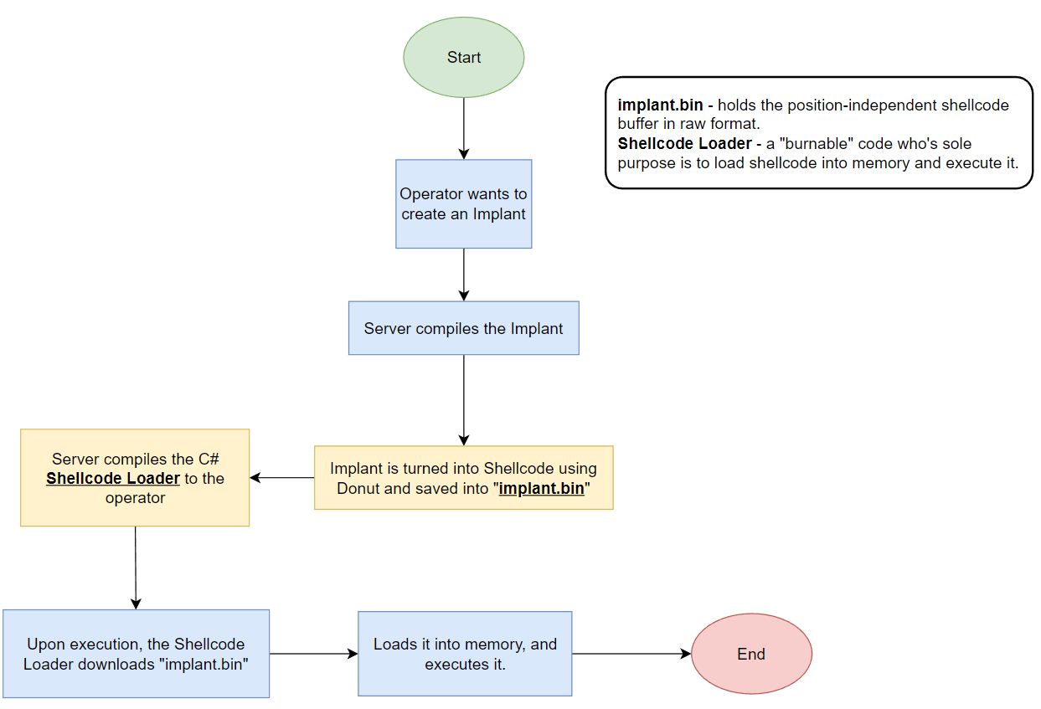
Implant Execution

Slide 13
References
Microsoft (2023, February). Dynamic Language Runtime Overview - .NET Framework. Microsoft Learn. https://learn.microsoft.com/en-us/dotnet/framework/reflection-and-codedom/dynamic-language-runtime-overview
Ali Awan, A. (2022, July). A Comprehensive Introduction to Graph Neural Networks (GNNs). https://www.datacamp.com/tutorial/comprehensive-introduction-graph-neural-networks-gnns-tutorial
G. Resto, K. Domenech, C. Roque Adversary Emulation Framework

Slide 14

Thank you

